Slide 1
Module 4
Issues in the design of code generator

Slide 2
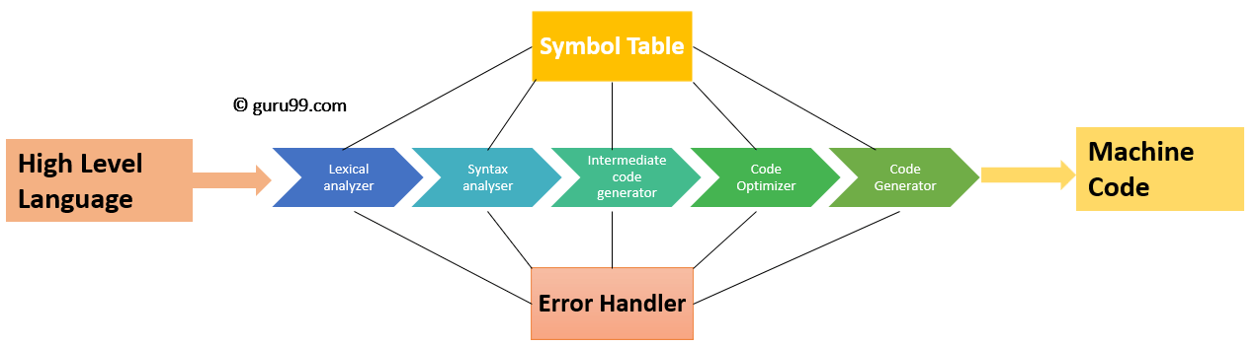
Position of Code Generator

Slide 3
Issues in Code Generator:
Input to code generator
Target program
Memory Management
Instruction selection
Register allocation issues
Evaluation order

Slide 4
Input to Code Generator
Intermediate codes may be represented mostly in quadruples, triples, indirect triples, Postfix notation, syntax trees, DAG’s, etc.
The code generation phase just proceeds on an assumption that the input are free from all of syntactic and state semantic errors, the necessary type checking has taken place and the type-conversion operators have been inserted wherever necessary.

Slide 5
Target program
The target program is the output of the code generator.
Absolute machine language as output has advantages that it can be placed in a fixed memory location and can be immediately executed.
Relocatable machine language as an output allows subprograms and subroutines to be compiled separately. Relocatable object modules can be linked together and loaded by linking loader. But there is added expense of linking and loading.
Assembly language as output makes the code generation easier. We can generate symbolic instructions and use macro-facilities of assembler in generating code. And we need an additional assembly step after code generation.

Slide 6
Memory Management
Mapping the names in the source program to the addresses of data objects is done by the front end and the code generator.
A name in the three address statements refers to the symbol table entry for name.
Then from the symbol table entry, a relative address can be determined for the name.

Slide 7
Instruction selection
The code generator takes the intermediate representation as input and converts it into target machine instruction set.
Nature of instruction set of the target machine should be complete and uniform i.e it includes the instructions that should be complete and uniform.
When we consider the efficiency of target machine then the instruction speed and machine idioms are important factors. If we do not care about the efficiency of the target program then instruction selection is straight-forward.
The quality of the generated code is determined by its speed and size.

Slide 8
Contd.
For example:- a = b+c
Mov b, Ro
ADD c, Ro
Mov Ro, a

Slide 9
Register allocation issues
The key problem in the code generation is deciding “what value to store in what register”?
In register allocation, instructions are consisting of Register operands and Memory operands.
Register operands can be accessed faster and they are short as compared to memory.
Memory operands can be accessed slower and they are large as compared to register.

Slide 10
Use of registers are subdivided into two subproblems:
Subproblems.
Register Allocation Register Assignment
Register Allocation:- we select the set of variables that will reside in register at a point in program.
Register Assignment:- we pick the specific register that a variable will reside in.

Slide 11
Evaluation order
* The code generator decides the order in which the instruction will be executed.
* The order in which computations are performed can affect the efficiency of the target code.
* When instructions are independent their evaluation order can be changed.
* Among many computational orders, some will require only fewer registers to hold the intermediate results.

Slide 12
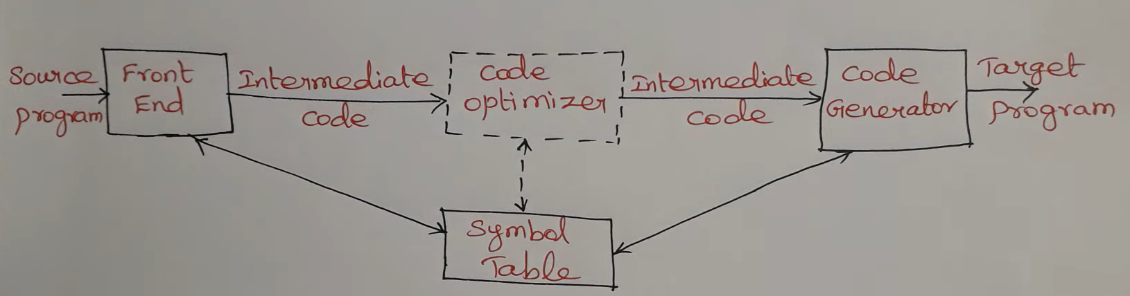
Position of code generator.
The final phase in compiler model is the code generator.
Code generator converts the intermediate representation of source code and produces as output an equivalent target program.
A code generator is expected to generate the correct code. Designing of code generator should be done in such a way so that it can be easily implemented, tested and maintained.

Slide 13
Target Machine
The target computer is a type of byte-addressable machine. It has 4 bytes to a word.
The target machine has n general purpose registers, R0, R1,...., Rn-1. It also has two-address instructions of the form: op source, destination.
Where, op is used as an op-code and source and destination are used as a data field.
It has the following op-codes: 1. ADD (add source to destination) 2. SUB (subtract source from destination) 3. MOV (move source to destination)
The source and destination of an instruction can be specified by the combination of registers and memory location with address modes.

Slide 14
Runtime Storage management
The information which required during an execution of a procedure is kept in a block of storage called an activation record. The activation record includes storage for names local to the procedure.
We can describe address in the target code using the following ways:
Static allocation
Stack allocation
In static allocation, the position of an activation record is fixed in memory at compile time.
In the stack allocation, for each execution of a procedure a new activation record is pushed onto the stack. When the activation ends then the record is popped.

Slide 15
Static Allocation
1.) Implementation of call statement
The following code is needed to implement static allocation:
MOV #here + 20, callee.static_area
GOTO callee.code_area
2.) Implementation of return statement:
The following code is needed to implement return from procedure called:
GOTO * callee.static_area
It is used to transfer the control to the address that is saved at the beginning of the activation record.
3.) Implementation of action statement:
The ACTION instruction is used to implement action statement.
4.) Implementation of halt statement:
The HALT statement is the final instruction that is used to return the control to the operating system.

Slide 16
Stack allocation
In stack allocation, register is used to store the position of activation record so words in activation records can be accessed as offsets from the value in this register.
The following code is needed to implement stack allocation:
1. Initialization of stack:
MOV #stackstart , SP
HALT
2. Implementation of Call statement:
ADD #caller.recordsize, SP
MOV #here + 16, *SP
GOTO callee.code_area
3. Implementation of Return statement:
GOTO *0 ( SP )
SUB #caller.recordsize, SP

Slide 17
Basic Blocks
Basic block contains a sequence of statement.
The flow of control enters at the beginning of the statement and leave at the end without any halt (except may be the last instruction of the block).
The following sequence of three address statements forms a basic block:
t1:= x * x
t2:= x * y
t3:= 2 * t2
t4:= t1 + t3
t5:= y * y
t6:= t4 + t5

Slide 18
Basic block construction
Algorithm: Partition into basic blocks
Input: It contains the sequence of three address statements
Output: it contains a list of basic blocks with each three address statement in exactly one block
Method: First identify the leader in the code. The rules for finding leaders are as follows:
The first statement is a leader.
Statement L is a leader if there is an conditional or unconditional goto statement like: if....goto L or goto L
Instruction L is a leader if it immediately follows a goto or conditional goto statement like: if goto B or goto B
For each leader, its basic block consists of the leader and all statement up to. It doesn't include the next leader or end of the program.

Slide 19
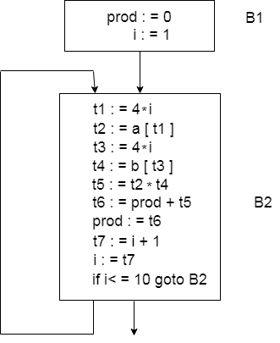
Flow Graph
Flow graph is a directed graph. It contains the flow of control information for the set of basic block.
A control flow graph is used to depict that how the program control is being parsed among the blocks. It is useful in the loop optimization.
Flow graph for the vector dot product is given as follows:-
Block B1 is the initial node. Block B2 immediately follows B1, so from B2 to B1 there is an edge.
The target of jump from last statement of B1 is the first statement B2, so from B1 to B2 there is an edge.
B2 is a successor of B1 and B1 is the predecessor of B2.

Slide 20
Code Generator
Code generator is used to produce the target code for three-address statements. It uses registers to store the operands of the three address statement.
Example:
Consider the three address statement x:= y + z. It can have the following sequence of codes:
MOV x, R0
ADD y, R0

Slide 21
DAG representation for basic blocks
A DAG for basic block is a directed acyclic graph with the following labels on nodes:
The leaves of graph are labeled by unique identifier and that identifier can be variable names or constants.
Interior nodes of the graph is labeled by an operator symbol.
Nodes are also given a sequence of identifiers for labels to store the computed value.
DAGs are a type of data structure. It is used to implement transformations on basic blocks.
DAG provides a good way to determine the common sub-expression.
It gives a picture representation of how the value computed by the statement is used in subsequent statements.

Slide 22
Algorithm for construction of DAG
Input: It contains a basic block
Output: It contains the following information:
Each node contains a label. For leaves, the label is an identifier.
Each node contains a list of attached identifiers to hold the computed values.
Case (i) x:= y OP z
Case (ii) x:= OP y
Case (iii) x:= y

Slide 23
PEEPHOLE OPTIMIZATION
Every tuple of the computation graph corresponds to some instruction of the target machine. It may be, however, that a sequence of several tuples can be implemented as a single instruction.
The purpose of peephole optimization is to combine such tuples, reducing the size of the basic block and the number of intermediate values.
A statement-by-statement code-generations strategy often produces target code that contains redundant instructions and suboptimal constructs. The quality of such target code can be improved by applying “optimizing” transformations to the target program.
A technique for improving the target code is peephole optimization, a method for trying to improving the performance of the target program by examining a short sequence of target instructions (called the peephole) and replacing these instructions by a shorter or faster sequence, whenever possible.

Slide 24
Characteristics of Peephole Optimization
Redundant load elimination is a common peephole optimization. A sequence of expressions that both modifies and uses the same variable can easily result in two adjacent instructions that save a register into memory, and then immediately load the same value again:
Before: MOVQ %R8, x MOVQ x, %R8
After: MOVQ %R8, x
A slight variation is that a load to a different register can be converted into a direct move between registers, thus saving an unnecessary load and pipeline stall:
Before: MOVQ %R8, x MOVQ x, %R9
After: MOVQ %R8, x MOVQ %R8, %R9

Slide 25
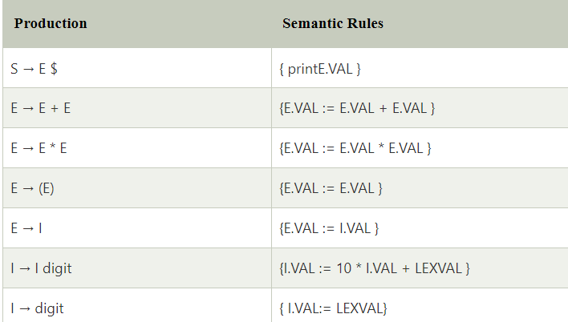
Syntax directed Translation Schemes
The Syntax directed translation scheme is a context -free grammar.
The syntax directed translation scheme is used to evaluate the order of semantic rules.
In translation scheme, the semantic rules are embedded within the right side of the productions.
The position at which an action is to be executed is shown by enclosed between braces. It is written within the right side of the production.
Example:-

Slide 26
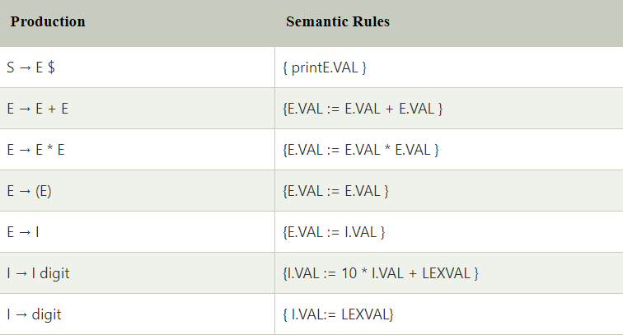
Implementation of Syntax directed translation
Syntax direct translation is implemented by constructing a parse tree and performing the actions in a left to right depth first order.
SDT is implementing by parse the input and produce a parse tree as a result.
Example

Slide 27
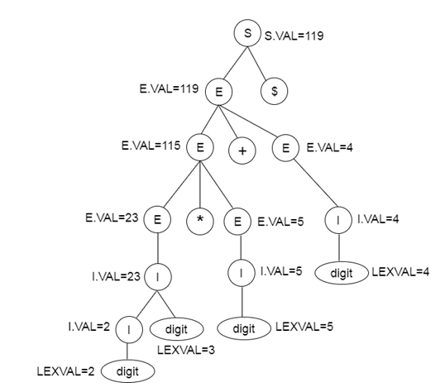
Parse tree for SDT:

Slide 28

Intermediate code
Intermediate code is used to translate the source code into the machine code. Intermediate code lies between the high-level language and the machine language.
If the compiler directly translates source code into the machine code without generating intermediate code then a full native compiler is required for each new machine.
The intermediate code keeps the analysis portion same for all the compilers that's why it doesn't need a full compiler for every unique machine.
Intermediate code generator receives input from its predecessor phase and semantic analyzer phase. It takes input in the form of an annotated syntax tree.
Using the intermediate code, the second phase of the compiler synthesis phase is changed according to the target machine.

Slide 29
Intermediate representation
Intermediate code can be represented in two ways:
1. High Level intermediate code
High level intermediate code can be represented as source code. To enhance performance of source code, we can easily apply code modification. But to optimize the target machine, it is less preferred.
2. Low Level intermediate code
Low level intermediate code is close to the target machine, which makes it suitable for register and memory allocation etc. it is used for machine-dependent optimizations.

Slide 30
Postfix Notation
Postfix notation is the useful form of intermediate code if the given language is expressions.
Postfix notation is also called as 'suffix notation' and 'reverse polish'.
Postfix notation is a linear representation of a syntax tree.
In the postfix notation, any expression can be written unambiguously without parentheses.
The ordinary (infix) way of writing the sum of x and y is with operator in the middle: x * y. But in the postfix notation, we place the operator at the right end as xy *.
In postfix notation, the operator follows the operand.

Slide 31
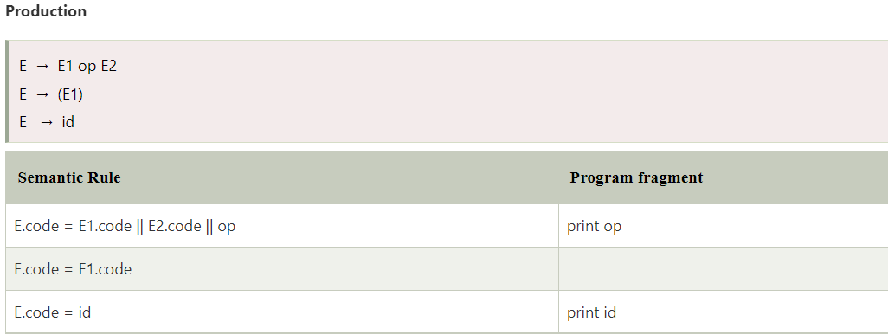
Example of Postfix Notation

Slide 32
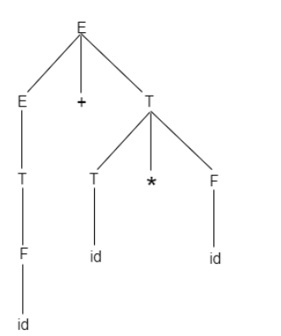
Parse tree and Syntax tree
When you create a parse tree then it contains more details than actually needed. So, it is very difficult to compiler to parse the parse tree. Take the following parse tree as an example:
In the parse tree, most of the leaf nodes are single child to their parent nodes.
In the syntax tree, we can eliminate this extra information.
Syntax tree is a variant of parse tree. In the syntax tree, interior nodes are operators and leaves are operands.
Syntax tree is usually used when represent a program in a tree structure.

Slide 33
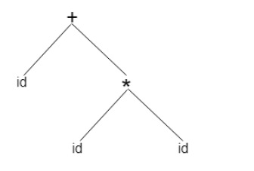
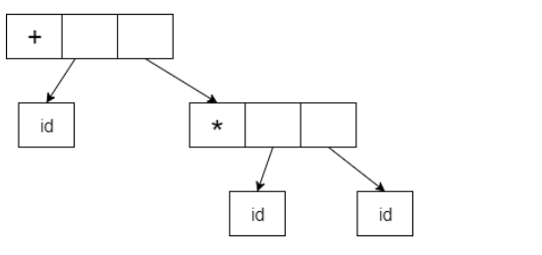
Syntax tree
A sentence id + id * id would have the following syntax tree:
Abstract syntax trees are important data structures in a compiler.
It contains the least unnecessary information.
Abstract syntax trees can be represented as:-

Slide 34
Three address code
Three-address code is an intermediate code. It is used by the optimizing compilers.
In three-address code, the given expression is broken down into several separate instructions. These instructions can easily translate into assembly language.
Each Three address code instruction has at most three operands. It is a combination of assignment and a binary operator.
General representation –
a = b op c

Slide 35
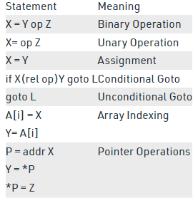
Types of Three-address codes

Slide 36
Example 1
a = b + c * d;
The intermediate code generator will try to divide this expression into sub-expressions and then generate the corresponding code.
r1 = c * d;
r2 = b + r1;
a = r2
r being used as registers in the target program.

Slide 37
TRIPLETS
The representation using triplets doesn’t make use of extra temporary variable to represent a single operation instead when a reference to another triple’s value is needed, a pointer to that triple is used.
It consist of only three fields namely op, arg1 and arg2 and it has no field for storing result, which is the case in quadruples.
The triples have three fields to implement the three address code. The field of triples contains the name of the operator, the first source operand and the second source operand.
In triples, the results of respective sub-expressions are denoted by the position of expression. Triple is equivalent to DAG while representing expressions.
So, in this representation
References to the instructions are made
Temporary variables are not used

Slide 38
Example: A :=-B*(C/D)
Step1
Writing the 3-address code
T1 : = - B (here, ‘-’ is considered as an unary operator)
T2 : = (C/D)
T3 : = T1 * T2
A : = T3 (storing the final result in A, which is T3)

Slide 39
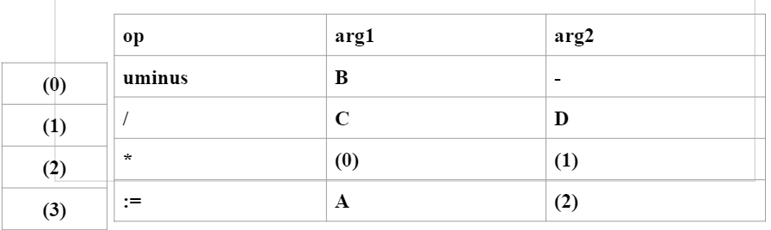
Contd..
Step2
Making the triplets

Slide 40
INDIRECT TRIPLETS
This representation is an enhancement over triples representation.
It uses an additional instruction array to list the pointers to the triples in the desired order.
Thus, instead of position, pointers are used to store the results.
It allows the optimizers to easily reposition the sub-expression for producing the optimized code.

Slide 41
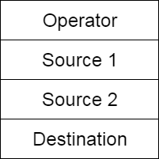
QUADRUPLES
Quadruples is a structure which consists of four fields: namely op, arg1, arg2 and result, where
The op field is used for storing the internal code of the operator.
The arg1 and arg2 fields are used for storing the two operands used.
The result field is used for storing the result of the expression.
Quadruples can be implemented using an enumerated type to represent the operations and pointers to symbol table entries to represent the operands.
The quadruples have four fields to implement the three address code. The field of quadruples contains the name of the operator, the first source operand, the second source operand and the result respectively.

Slide 42
Example: A :=-B*(C/D)
Step1
Writing the 3-address code
T1 : = - B (here, ‘-’ is considered as an unary operator)
T2 : = (C/D)
T3 : = T1 * T2
A : = T3 (storing the final result in A, which is T3)

Slide 43
Contd..
Step2
Making the Quadruples
 | OP | ARG1 | ARG2 | RESULT
(0) | uminus | B | - | T1
(1) | / | C | D | T2
(2) | * | T1 | T2 | T3
(3) | := | T3 | - | A

Slide 44
Advantages and Disadvantages of Triplets
Advantages –
Its similar in utility as compared to quadruple representation but requires less space than it.
Disadvantages –
Temporaries are implicit and difficult to rearrange code.
It is difficult to optimize because optimization involves moving intermediate code.

Slide 45
Advantages and Disadvantages of Quadruples
Advantages –
Easy to rearrange code for global optimization
One can quickly access value of temporary variables using symbol table
Disadvantages –
Contain lot of temporaries
Temporary variable creation increases time and space complexity

Slide 46
Translation of Assignment Statements
An assignment statement sets the current value of a variable, field, parameter, or element.
The statement consists of an assignment target followed by the assignment operator and an expression.
When the statement is executed, the expression is evaluated and the resulting value is stored in the target.
In the syntax directed translation, assignment statement is mainly deals with expressions.
The expression can be of type real, integer, array and records.

Slide 47
How do they work?
Consider the grammar
S → id := E
E → E1 + E2
E → E1 * E2
E → (E1)
E → id

Slide 48
Contd..
The translation scheme of above grammar is given below:-
Production Rule | Semantic action
S → id :=E | {p = look_up(id.name); If p ≠ nil then Emit (p = E.place) Else Error; }
E → E1 + E2 | {E.place = newtemp(); Emit (E.place = E1.place '+' E2.place) }
E → E1 * E2 | {E.place = newtemp(); Emit (E.place = E1.place '*' E2.place) }
E → (E1) | {E.place = E1.place}
E → id | {p = look_up(id.name); If p ≠ nil then Emit (p = E.place) Else Error; }

Slide 49
Contd.
The p returns the entry for id.name in the symbol table.
The Emit function is used for appending the three address code to the output file. Otherwise it will report an error.
The newtemp() is a function used to generate new temporary variables.
E.place holds the value of E.

Slide 50
Boolean Expressions
Boolean expressions have two primary purposes. They are used for computing the logical values. They are also used as conditional expression using if-then-else or while-do.
Consider the grammar
E → E OR E
E → E AND E
E → NOT E
E → (E)
E → id relop id
E → TRUE
E → FALSE
The relop is denoted by <, >, <, >.
The AND and OR are left associated. NOT has the higher precedence then AND and lastly OR.

Slide 51
Control Statements
Control statements are the statements that change the flow of execution of statements.
Consider the Grammar
S → if E then S1
|if E then S1 else S2
|while E do S1
In this grammar, E is the Boolean expression depending upon which S1 or S2 will be executed.

Slide 52
Contd.
The goto statement alters the flow of control. If we implement goto statements then we need to define a LABEL for a statement. A production can be added for this purpose:
S → LABEL : S
LABEL → id
In this production system, semantic action is attached to record the LABEL and its value in the symbol table.
Following grammar used to incorporate structure flow-of-control constructs:
S → if E then S
S → if E then S else S
S → while E do S
S → begin L end
S→ A
L→ L ; S
L → S
Here, S is a statement, L is a statement-list, A is an assignment statement and E is a Boolean-valued expression.

Slide 53
Postfix Translation
In a production A → α, the translation rule of A.CODE consists of the concatenation of the CODE translations of the non-terminals in α in the same order as the non-terminals appear in α.
Production can be factored to achieve postfix form.
Postfix translation of while statement
The production
S → while M1 E do M2 S1
Can be factored as:
S → C S1
C → W E do
W → while

Slide 54
Contd.
Postfix translation of for statement
The production
S for L = E1 step E2 to E3 do S1
Can be factored as
F → for L
T → F = E1 by E2 to E3 do
S → T S1

Slide 55
Array references in arithmetic expressions
Elements of arrays can be accessed quickly if the elements are stored in a block of consecutive location. Array can be one dimensional or two dimensional.
For one dimensional array:
A: array[low..high] of the ith elements is at:
base + (i-low)*width → i*width + (base - low*width)
Multi-dimensional arrays:
Row major or column major forms
Row major: a[1,1], a[1,2], a[1,3], a[2,1], a[2,2], a[2,3]
Column major: a[1,1], a[2,1], a[1, 2], a[2, 2],a[1, 3],a[2,3]
In raw major form, the address of a[i1, i2] is
Base+((i1-low1)*(high2-low2+1)+i2-low2)*width

Slide 56
Procedures call
Procedure is an important and frequently used programming construct for a compiler. It is used to generate good code for procedure calls and returns.
Calling sequence:
The translation for a call includes a sequence of actions taken on entry and exit from each procedure.
Following actions take place in a calling sequence:
When a procedure call occurs then space is allocated for activation record.
Evaluate the argument of the called procedure.
Establish the environment pointers to enable the called procedure to access data in enclosing blocks.
Save the state of the calling procedure so that it can resume execution after the call.
Also save the return address. It is the address of the location to which the called routine must transfer after it is finished.
Finally generate a jump to the beginning of the code for the called procedure.

Slide 57
Declarations
When we encounter declarations, we need to lay out storage for the declared variables.
For every local name in a procedure, we create a ST(Symbol Table) entry containing:
The type of the name
How much storage the name requires
The production:
D → integer, id
D → real, id
D → D1, id

Slide 58
Case Statements
Switch and case statement is available in a variety of languages.
The syntax of case statement is as follows:
switch E
begin
case V1: S1
case V2: S2
.
.
.
case Vn-1: Sn-1
default: Sn
end

Slide 59
Contd.
The translation scheme for this shown below:
goto TEST
L1: code for S1
L2: code for S2
goto NEXT
.
.
Ln-1: code for Sn-1
goto NEXT
Ln: code for Sn
goto NEXT
TEST: if T = V1 goto L1
if T = V2goto L2
.
if T = Vn-1 goto Ln-1
goto
NEXT:

Slide 60
Data Structure for Symbol Table
Symbol table is an important data structure used in a compiler.
Symbol table is used to store the information about the occurrence of various entities such as objects, classes, variable name, interface, function name etc. it is used by both the analysis and synthesis phases.
A compiler contains two type of symbol table: global symbol table and scope symbol table.
Global symbol table can be accessed by all the procedures and scope symbol table.
The symbol table used for following purposes:
It is used to store the name of all entities in a structured form at one place.
It is used to verify if a variable has been declared.
It is used to determine the scope of a name.
It is used to implement type checking by verifying assignments and expressions in the source code are semantically correct.

Slide 61
Symbol Table
A symbol table can either be linear or a hash table.
Using the following format, it maintains the entry for each name.
<symbol name, type, attribute>
For example, suppose a variable store the information about the following variable declaration:
static int salary
then, it stores an entry in the following format:
<salary, int, static>
The clause attribute contains the entries related to the name.

Slide 62
Representing Scope Information
In the source program, every name possesses a region of validity, called the scope of that name.
The rules in a block-structured language are as follows:
If a name declared within block B then it will be valid only within B.
If B1 block is nested within B2 then the name that is valid for block B2 is also valid for B1 unless the name's identifier is re-declared in B1.
These scope rules need a more complicated organization of symbol table than a list of associations between names and attributes.
Tables are organized into stack and each table contains the list of names and their associated attributes.
Whenever a new block is entered then a new table is entered onto the stack. The new table holds the name that is declared as local to this block.
When the declaration is compiled then the table is searched for a name.
If the name is not found in the table then the new name is inserted.
When the name's reference is translated then each table is searched, starting from the each table on the stack.

Slide 63
Implementation of simple Stack allocation scheme
Stack Allocation scheme is the simplest Run-Time Storage Management Technique.
The storage is allocated sequentially in the stack beginning at one end. Storage should be freed in the reverse order of allocation so that a block of storage being released is always at the top of the stack.
A program consists of data and procedures. On execution of each procedure, some amount of memory is occupied, which has information regarding the procedure, i.e., its actual parameters, number of arguments, return address, return values & local data, etc. That part of memory is the Activation Record of that procedure.
Activation Record
An Activation Record is a data structure that is activated/ created when a procedure/function is invoked, and it contains the following information about the function.

Slide 64
Storage Allocation
Storage allocation is the process of associating an area of storage with a variable so that the data item(s) represented by the variable can be recorded internally.
When storage is associated with a variable, the variable is allocated. The storage class determines the degree of storage control an
The storage class assigned to a variable determines the degree of storage control applied to the variable's storage and the manner in which the variable's storage is allocated and freed. d the manner in which storage is allocated and freed.

Slide 65
Storage Allocation
The different ways to allocate memory are:
Static storage allocation
Stack storage allocation
Heap storage allocation

Slide 66
Static storage allocation
In static allocation, names are bound to storage locations.
If memory is created at compile time then the memory will be created in static area and only once.
Static allocation supports the dynamic data structure that means memory is created only at compile time and deallocated after program completion.
The drawback with static storage allocation is that the size and position of data objects should be known at compile time.
Another drawback is restriction of the recursion procedure.

Slide 67
Stack Storage Allocation
In static storage allocation, storage is organized as a stack.
An activation record is pushed into the stack when activation begins and it is popped when the activation end.
Activation record contains the locals so that they are bound to fresh storage in each activation record. The value of locals is deleted when the activation ends.
It works on the basis of last-in-first-out (LIFO) and this allocation supports the recursion process.

Slide 68
Heap Storage Allocation
Heap allocation is the most flexible allocation scheme.
Allocation and deallocation of memory can be done at any time and at any place depending upon the user's requirement.
Heap allocation is used to allocate memory to the variables dynamically and when the variables are no more used then claim it back.
Heap storage allocation supports the recursion process.

Slide 69
Module 5

Slide 70
PRINCIPAL SOURCES OF OPTIMISATION
A transformation of a program is called local if it can be performed by looking only at the statements in a basic block; otherwise, it is called global.
Many transformations can be performed at both the local and global levels. Local transformations are usually performed first.
Function-Preserving Transformations
There are a number of ways in which a compiler can improve a program without changing the function it computes.

Slide 71
Optimization of Basic Blocks
Optimization process can be applied on a basic block.
While optimization, we don't need to change the set of expressions computed by the block.
There are two type of basic block optimization. These are as follows:
Structure-Preserving Transformations
Algebraic Transformations

Slide 72
Structure preserving transformations
The primary Structure-Preserving Transformation on basic blocks is as follows:
Common sub-expression elimination
Dead code elimination
Renaming of temporary variables
Interchange of two independent adjacent statements
1.) Common sub-expression elimination:
In the common sub-expression, you don't need to be computed it over and over again. Instead of this you can compute it once and kept in store from where it's referenced when encountered again.

Slide 73
Contd.
Example
a : = b + c
b : = a - d
c : = b + c
d : = a - d
In the above expression, the second and forth expression computed the same expression. So the block can be transformed as follows:
a : = b + c
b : = a - d
c : = b + c
d : = b

Slide 74
Contd..
(2) Dead-code elimination
It is possible that a program contains a large amount of dead code.
This can be caused when once declared and defined once and forget to remove them in this case they serve no purpose.
Suppose the statement x:= y + z appears in a block and x is dead symbol that means it will never subsequently used. Then without changing the value of the basic block you can safely remove this statement.
(3) Renaming temporary variables
A statement t:= b + c can be changed to u:= b + c where t is a temporary variable and u is a new temporary variable. All the instance of t can be replaced with the u without changing the basic block value.
(4) Interchange of statement
Suppose a block has the following two adjacent statements:
t1 : = b + c
t2 : = x + y
These two statements can be interchanged without affecting the value of block when value of t1 does not affect the value of t2.

Slide 75
Algebraic transformations
In the algebraic transformation, we can change the set of expression into an algebraically equivalent set. Thus the expression x:= x + 0 or x:= x *1 can be eliminated from a basic block without changing the set of expression.
Constant folding is a class of related optimization. Here at compile time, we evaluate constant expressions and replace the constant expression by their values. Thus the expression 5*2.7 would be replaced by13.5.
Sometimes the unexpected common sub expression is generated by the relational operators like <=, >=, <, >, +, = etc.
Sometimes associative expression is applied to expose common sub expression without changing the basic block value. if the source code has the assignments.

Slide 76
Global data flow analysis
To efficiently optimize the code compiler collects all the information about the program and distribute this information to each block of the flow graph. This process is known as data-flow graph analysis.
Certain optimization can only be achieved by examining the entire program. It can't be achieve by examining just a portion of the program.
For this kind of optimization user defined chaining is one particular problem.
Here using the value of the variable, we try to find out that which definition of a variable is applicable in a statement.
Data flow analysis is used to discover this kind of property. The data flow analysis can be performed on the program's control flow graph (CFG).
The control flow graph of a program is used to determine those parts of a program to which a particular value assigned to a variable might propagate.

Slide 77
Example
Based on the local information a compiler can perform some optimizations. For example, consider the following code:
x = a + b;
x = 6 * 3
In this code, the first assignment of x is useless. The value computer for x is never used in the program.
At compile time the expression 6*3 will be computed, simplifying the second assignment statement to x = 18;

Slide 78
Run-Time Environment
Runtime environment is a state of the target machine, which may include software libraries, environment variables, etc., to provide services to the processes running in the system.
Runtime support system is a package, mostly generated with the executable program itself and facilitates the process communication between the process and the runtime environment.
It takes care of memory allocation and de-allocation while the program is being executed.

Slide 79
RUN-TIME ENVIRONMENTS - SOURCE LANGUAGE ISSUES
Procedures:
A procedure definition is a declaration that associates an identifier with a statement.
The identifier is the procedure name, and the statement is the procedure body.
For example, the following is the definition of procedure named readarray :
procedure readarray; var i : integer;
begin
for i : = 1 to 9 do read(a[i])
end;
When a procedure name appears within an executable statement, the procedure is said to be called at that point.

Slide 80
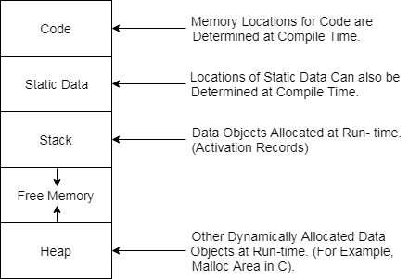
Storage Organization
When the target program executes then it runs in its own logical address space in which the value of each program has a location.
The logical address space is shared among the compiler, operating system and target machine for management and organization.
The operating system is used to map the logical address into physical address which is usually spread throughout the memory.
Subdivision of Run-time Memory:

Slide 81
Storage Allocation strategies
There are various storage allocation techniques are as follows:-
1.Static Allocation
It is the simplest allocation scheme in which allocation of data objects is done at compile time because the size of every data item can be determined by the compiler.
Advantages
It is easy to implement.
It allows type checking during compilation.
It eliminates the feasibility of running out of memory.
Disadvantages
It is incompatible with recursive subprograms.
It is not possible to use variables whose size has to be determined at run time.
The static allocation can be completed if the size of the data object is called compile time.

Slide 82
Contd.
2. Dynamic Allocation (Stack Allocation)
The stack allocation is a runtime storage management technique.
The activation records are pushed and popped as activations begin and end respectively.
Storage for the locals in each call of the procedure is contained in the activation record for that call.
It can be determined the size of the variables at a run time & hence local variables can have different storage locations & different values during various activations.
It allows recursive subprograms.
Advantages
It supports recursion.
It creates a data structure for the data item dynamically.
Disadvantages
Memory Addressing can be done using pointers & index Registers.

Slide 83
Contd.
3.Heap Storage Allocation
It enables the allocation of memory in a Non-nested design. Storage can be allocated & freed arbitrarily from an area known as Heap.
Heap Allocation is helpful for executing data whose size varies as the program is running.
Heap is maintained as a list of free space called free space list.
Advantages
A large block of storage can be partitioned into smaller blocks at run time.
Disadvantages
It creates the problem of fragmentation.

Slide 84
Parameter Passing
The communication medium among procedures is known as parameter passing.
The values of the variables from a calling procedure are transferred to the called procedure by some mechanism.
Before moving ahead, first go through some basic terminologies pertaining to the values in a program.
r-value
The value of an expression is called its r-value. The value contained in a single variable also becomes an r-value if it appears on the right-hand side of the assignment operator. r-values can always be assigned to some other variable.
l-value
The location of memory (address) where an expression is stored is known as the l-value of that expression. It always appears at the left hand side of an assignment operator.

Slide 85
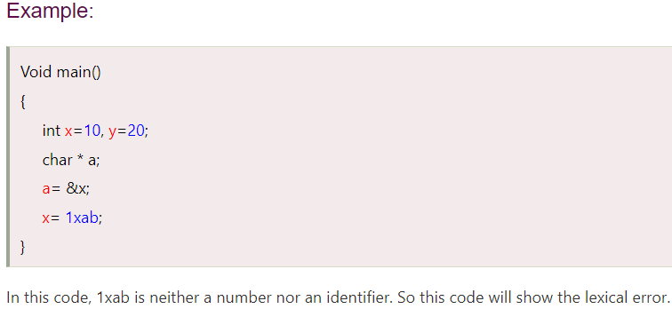
Lexical Phase Error
Lexical error is a sequence of characters that does not match the pattern of any token. Lexical phase error is found during the execution of the program. During the lexical analysis phase this type of error can be detected.
Lexical phase error can be:
Spelling error.
Exceeding length of identifier or numeric constants.
Appearance of illegal characters.
To remove the character that should be present.
To replace a character with an incorrect character.
Transposition of two characters.

Slide 86
Syntax Phase Error
Syntax error is found during the execution of the program.
During the syntax analysis phase, this type of error appears.
Some syntax error can be:
Error in structure
Missing operators
Unbalanced parenthesis
When an invalid calculation enters into a calculator then a syntax error can also occurs. This can be caused by entering several decimal points in one number or by opening brackets without closing them.

Slide 87
Semantic Phase Error
These types of error are detected at compile time.
During the semantic analysis phase, this type of error appears.
Most of the compile time errors are scope and declaration error.
For example: undeclared or multiple declared identifiers. Type mismatched is another compile time error.
The semantic error can arises using the wrong variable or using wrong operator or doing operation in wrong order.
Some semantic error can be:
Incompatible types of operands
Undeclared variable
Not matching of actual argument with formal argument

Slide 88
Loop Optimization
Loop optimization is most valuable machine-independent optimization because program's inner loop takes bulk to time of a programmer.
If we decrease the number of instructions in an inner loop then the running time of a program may be improved even if we increase the amount of code outside that loop.
For loop optimization the following three techniques are important:
Code motion
Induction-variable elimination
Strength reduction

Slide 89
Contd.
Code motion
Code motion is used to decrease the amount of code in loop.
This transformation takes a statement or expression which can be moved outside the loop body without affecting the semantics of the program.
For example
In the while statement, the limit-2 equation is a loop invariant equation.
while (i<=limit-2)
After code motion the result is as follows:
a= limit-2;

Slide 90
Contd..
Induction-variable elimination
Induction variable elimination is used to replace variable from inner loop.
It can reduce the number of additions in a loop.
It improves both code space and run time performance.
Reduction in Strength
Strength reduction is used to replace the expensive operation by the cheaper once on the target machine.
Addition of a constant is cheaper than a multiplication. So we can replace multiplication with an addition within the loop.
Multiplication is cheaper than exponentiation. So we can replace exponentiation with multiplication within the loop.

Slide 91
Value numbers and Algebraic laws
A value number is a number associated with each variable used within the basic block.
It uniquely identifies the place in the basic block where the variable was last assigned a value.
The value number of all the variables are initialized at the start of the basic block.
For identifying the common sub-expression in directed acyclic graph a data structure hash table was used and this idea was termed as the value number method.

Slide 92
Algebraic Identities and Laws
The value number method discussed above is useful in the implementation of certain optimizations based on algebraic laws. These algebraic are:-
x = x * 1 x = x + 0
Commutativity:- in algebra the addition and multiplication operations are associated eg
a + b = b + a
a * b = b * a
Associativity:-
a + ( b + c ) = ( a + b ) + c

